Slide 1

FOOD
ORDERING
SYSTEM
Web Programming Project
DELICIOUS!
Teacher: Mr. Dao Thanh Chung
Team members:
Nguyen Duc Dat
Nguyen Trinh Vu
Nguyen The Chinh

Slide 2
TABLE OF CONTENTS
01
INTRODUCTION
02
TECHNICAL PREVIEW
FEATURES
04
CONCLUSION
03

Slide 3
01
INTRODUCTION
HELLO

Slide 4
ABOUT THE PROJECT
Restaurant website that customers can:
Easily check the menu with details of each meals
Register for restaurant-member discount
Order and checkout easily
See order history
LET’S MAKE SOME ORDERS

Slide 5
02
TECHNICAL
PREVIEW
HOW?
Front-end, Back-end, Database

Slide 6



REACTJS
PHP
MYSQL

Slide 7
03
FEATURES
WHAT CAN IT DO?

Slide 8
FEATURES
REGISTER
LOGIN / LOGOUT
CHANGE PASSWORD
ORDER HISTORY
SHOW CART
CHECKOUT

Slide 9
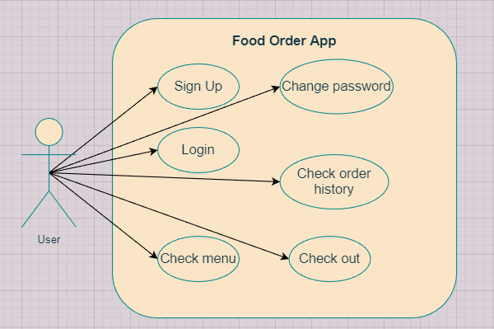
USE CASE DIAGRAM

Slide 10
04
CONCLUSION
FINALLY

Slide 11


OUR MEMBERS
LEADER
TRINH VU
DUC DAT
THE CHINH
Authentication,
Database
Prepare menu,
Order history
Order progress, Responsive

Slide 12
RESULT
DIFFICULTY
Successfully build a complete app with all functions work.
Everyone helps each other and contributes work in both front-end and back-end.
The product is still simple
Need to improve and upgrade more features

Slide 13
THANKS!
DO YOU HAVE ANY QUESTIONS?
TASTY

